Slide 1
Shadow Mapping
Let’s ruin Skyrim!

Slide 2
What is Shadow Mapping
Highly used technique to create shadows in real time rendering.
This is a multi-pass technique (at least two passes)
Depths from light are rendered in one pass then these values are compared to the depth from light of pixels actually being rendered in a second pass.

Slide 3
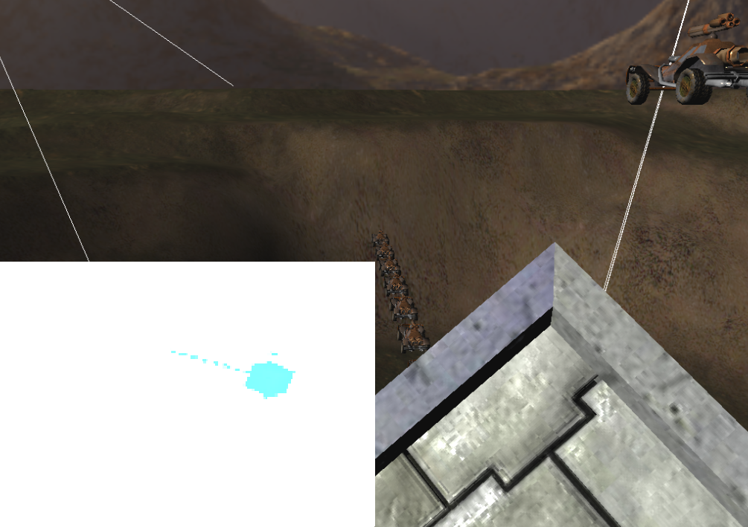
Simple Shadow Mapping Step 1
Render the scene from the perspective of the light to a texture.
Only render depth values, not normal color information.

Slide 4
Simple Shadow Mapping Step 1
How do we render depth values?
The output of our shader is always a float4 representing a color.
return float4(depth, 0, 0, 1);
The vertex shader will transform the point by the a matrix representing the light’s view-projection.
The Z component of this transformed vertex is the depth from the light.

Slide 5
Simple Shadow Mapping Step 1
The color output of a shader is limited to values ranging from 0 – 1
The Z component of our position ranges from Near Clip Plane distance – Far Clip Plane distance
Dividing by the W component will put a vertex value into clip space, -1 to +1
Negative Z values in clip space represent things behind the near plane, which won’t be rendered so, depth = position.z/position.w

Slide 6
Simple Shadow Mapping Step 1
Only writing to the red channel seems wasteful. In the old days we would pack the value across all the components.
The way easier way is to just pick a pixel format for our render target that uses all the memory for the red channel, such as D3DFMT_R32F
We can also disable the color writes for the other channels, like we did for the depth pass in our deferred renderer

Slide 7
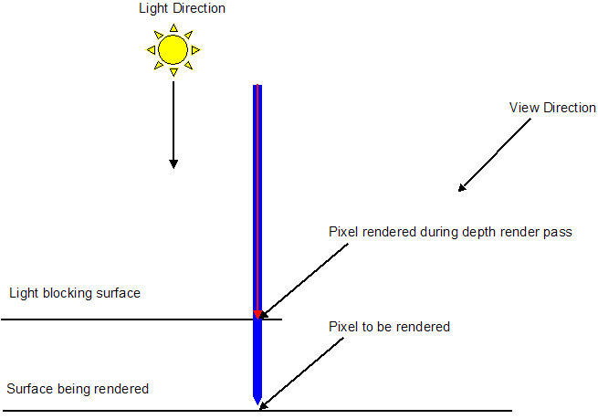
Simple Shadow Mapping Step 2
Once we have a texture with the depth values for the light we can do our “normal” render.
In our fragment shader we will compare the depth of the fragment, from the light, to the value in the texture. If our depth is greater, we are in shadow.

Slide 8
Simple Shadow Mapping Step 2
We will need our position in light space
We can just transform our vertex by the same lightMVP matrix we used in step one.
In a forward renderer this would happen in the vertex shader, we will have to do it per fragment, per light in a deferred renderer.

Slide 9
Simple Shadow Mapping Step 2
Our fragments depth is our lightSpacePos.z/ lightSpacePos.w
We will need to sample the texture created in step 1 to find the depth to compare to.
The texcoord for sampling is (lightSpacePos.xy/ lightSpacePos.w + 1) / 2
if(sampleDepth < ourDepth)
//this fragment is in shadow

Slide 10
Light View-Projection Matrix
We will need to build a view-projection matrix to represent the view from the light.
This is like having a camera controlled by a light.
Building this will be different for each type of light you may wish to support, such as directional, spot or point.

Slide 11
Building a spot light view-projection
The spot light tends to be the easiest.
Our view matrix is just the inverted world matrix made up of the spot light
The world matrix should have the spot position for the translation and the direction for the Zaxis, make sure the other are orthogonal and you are set.
We will use a perspective projection.
The projection matrix just needs the spot’s cutoff value to determine the field of view.

Slide 12
Directional Light Matrix
We want to use an orthographic projection due to the parallel line nature of a direction light
The combination of the orthographic projection and translation of the view matrix define a box where shadows can be cast.
If this box is really big, we get really low resolution shadows.

Slide 13
Directional Light Matrix
We want to define an orthographic projection box based on the area in view.
We will want to translate our view to keep the box representing our viewable area.
Each Frame -
Build an AABB or OBB based on the frustum points, use its sides to define our orthographic.
Build a view matrix based off the light direction and the camera’s position.
The result will be “shimmering” shadows.

Slide 14
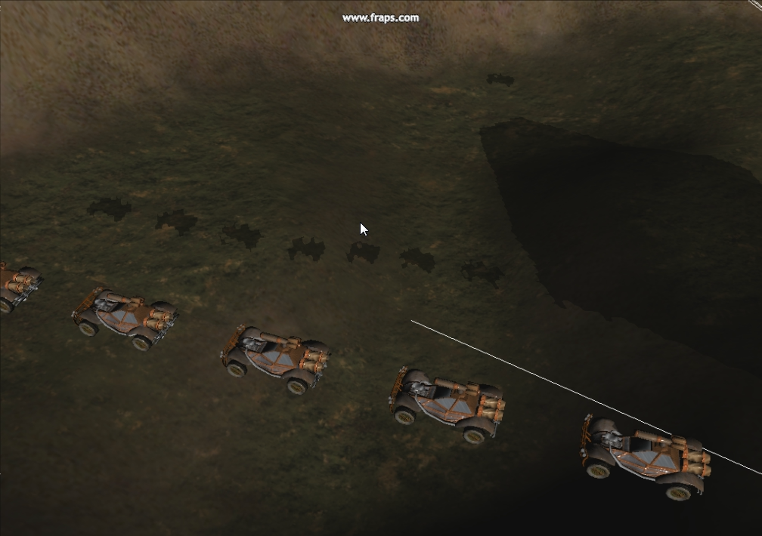
Shimmering Shadows

Slide 15
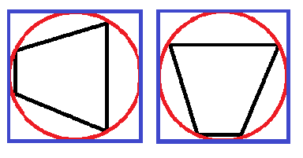
Shimmering Shadows
This shimmering is caused by the depth values falling on different texels each frame.
This happens because we change the projection and view each frame.
If we base the projection off of an AABB around a sphere, around the frustum we only have to build it once.

Slide 16
Shimmering Shadows
Now the only thing that needs to change each frame is the view translation.
We need to limit movement to be in whole texels to not cause shimmering when we translate.
We will build a matrix to do this, mRound.
Ultimately, we will multiply our view-projection by mRound to cancel out and sub-texel movement.

Slide 17
mRound
We start by transforming any point in space by our light view-projection, lightSpacePoint.
Then, we put this point into texel space, lightSpacePoint * shadow map size * 0.5f
Store the result of rounding lightSpacePoint to the nearest whole number, then find the difference between the rounded and pre rounded values, dx and dy.

Slide 18
mRound
We put these difference values back into light space, dx, dy /= shadow map size * 0.5f
Next we build a translation matrix with the dx and dy values, this is mRound
Light view-projection *= mRound will result in all translations being rounded to the nearest texel and remove all shimmering.

Slide 19
Point Light Matrices
The typical way to do shadow mapping with a point light is to use one perspective projection with six view matrices and textures.
We need six because a point light shines in all directions.
We will use a view matrix and texture for the +X, -X, +Y, -Y, +Z and –Z directions.
The depth write pass for a point light will have to be done for each of these six directions.
We often use a cube map texture for the six textures.

Slide 20
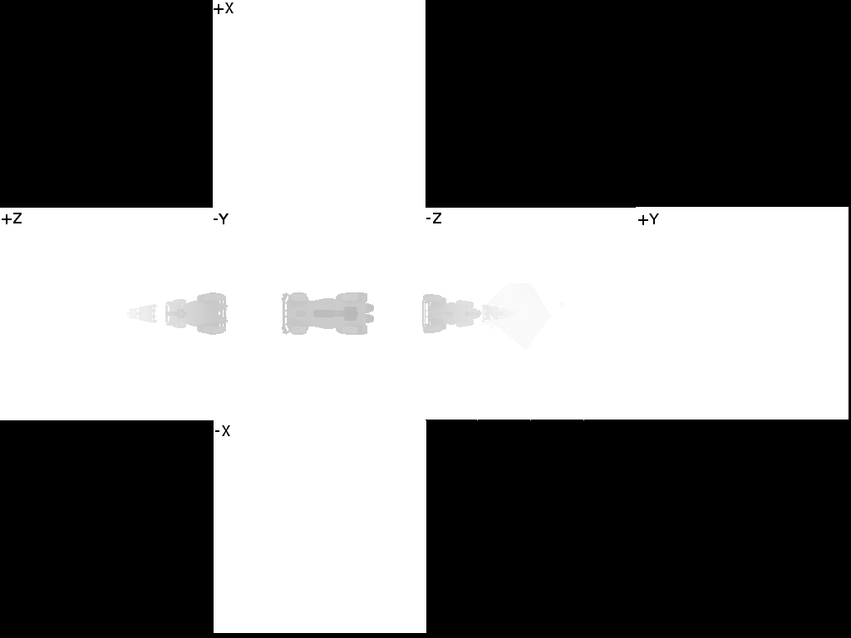
Point Light Shadow Map

Slide 21
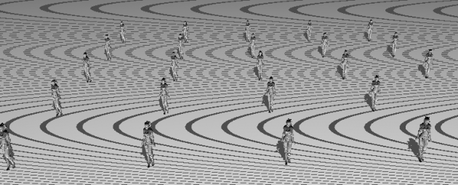
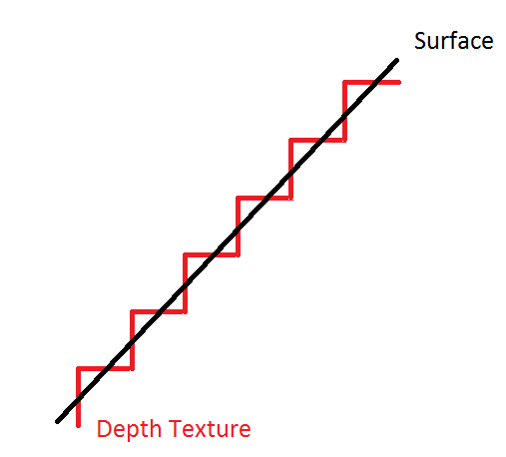
Self Shadowing Issues
Limited precision can cause “surface acne”

Slide 22
Surface Acne
There are two main fixes to this issue
Render back faces only during depth pass
This will push depth values back, and remove acne from front faces
Objects without back faces will not cast shadows!
Add a bias value to depth compares
Gross magic number that has to be set by hand for the situation, different scenes and lights will require different values.
This is the current accepted solution. =(

Slide 23
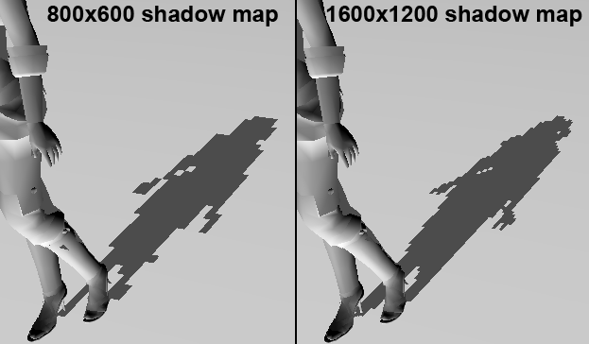
Simple Shadow Mapping
Our Simple Shadow Maps, SSM, will result in hard pixilated shadows.
This can be improved by increasing our shadow map size…mo’ memory mo’ problems.

Slide 24
Beyond SSM
There are a ton of different shadow mapping solutions, all based on SSM.
Splitting methods
PSSM, CSM
Warping Methods
LiSPSM, TSM, PSM
Smoothing
PCF
Filtering
ESM, CSM, VSM, SAVSM
Soft Shadows
PCSS
And about 20 more

Slide 25
Simple Softer Shadows
We typically achieve softer shadows by doing some form of blur.
During our depth compare step, we could look at all the texels around us and average the shadow results.
This is far from perfect, but is easy peasy and looks decent for directional lights for about 2 minutes extra work.

Slide 26
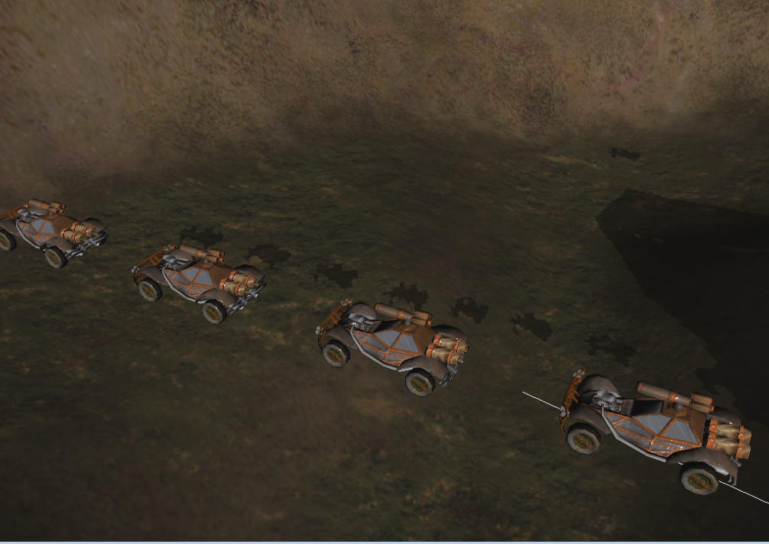
No blur

Slide 27
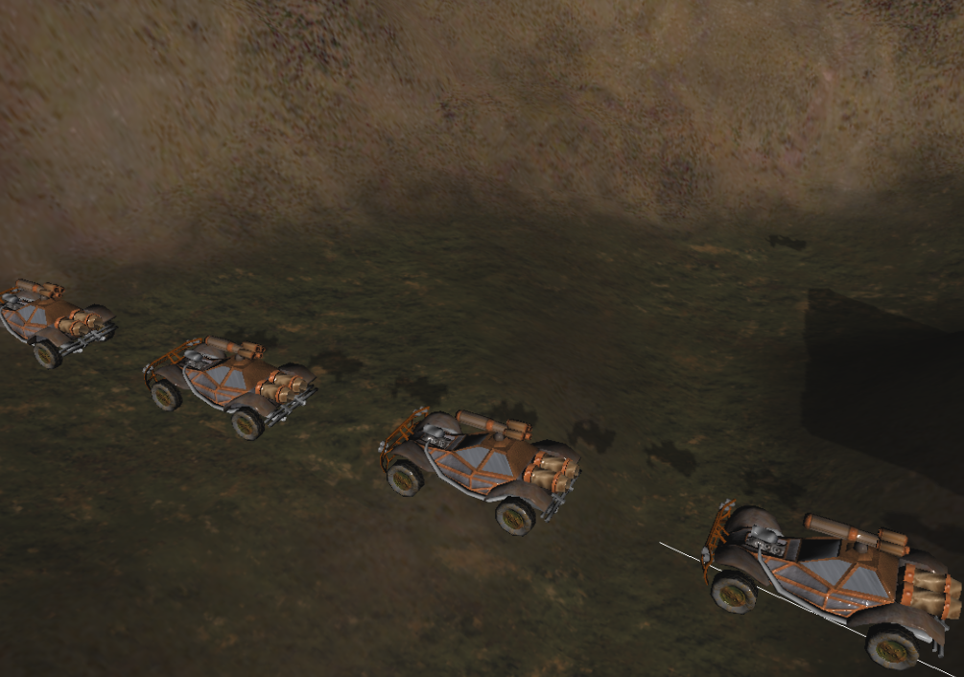
3x3 texel space blur

Slide 28
Deferred Shadow Maps
Similar idea to a deferred renderer
We will do a pass where we just compute the shadows, and write that out to a separate buffer.
Then we will overlay that on our finished scene render pass.
All our lights shadow’s will end up written to the same texture.
This can reduce the number of active textures, and the number of registers being used at one time. Which is mostly helpful for a forward renderer.
This also allows for a screen space blur of the shadows.

Slide 29
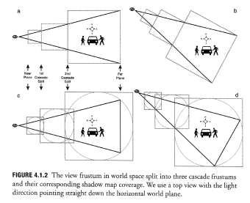
Cascade Shadow Maps
The idea with CSM is to split our frustum into multiple sections, each with there own shadow map, to increase precision.
This is very useful for large outdoor scenes with directional lights.

